Slide 1
Customer segmentation using Rfm Analysis
Project 1
IE6400 Foundations Data Analytics Engineering
Fall 2023 Semester
Group 6-
Giridhar Babu
Hemant Manohar Deshmukh
Mallika Gaikwad
Sharvari Pravin Deshpande
Medhavi Uday Pande

Slide 2
Introduction
In the rapidly evolving landscape of eCommerce, understanding and responding to customer behavior is paramount for businesses striving to stay ahead in a competitive market. The vast amounts of data generated in this digital realm present an opportunity for businesses to extract meaningful insights that can drive targeted strategies for marketing and customer retention. One such potent methodology is the RFM (Recency, Frequency, Monetary) analysis model. This project embarks on a journey to harness the power of RFM analysis using an expansive eCommerce dataset. Sourced from Kaggle, this dataset encapsulates a treasure trove of transactional data, providing a rich canvas for unraveling the intricacies of customer purchasing behavior. The overarching goal is to construct a robust Customer Segmentation model, leveraging the nuanced dimensions of recency, frequency, and monetary value.

Slide 3
Data Sources
UCI Machine Learning Repository
In aligning with best practices for data preprocessing and ensuring its reliability for analytical purposes, meticulous steps were undertaken. These encompassed initial data acquisition, thorough examination, and rigorous cleaning procedures.
It is imperative to recognize that while the dataset provides a comprehensive overview of transactions and customer interactions, the accuracy and efficacy of analyses conducted are contingent upon the quality of the original records maintained in the database.
These encompassed initial data acquisition, thorough examination, and rigorous cleaning procedures

Slide 4
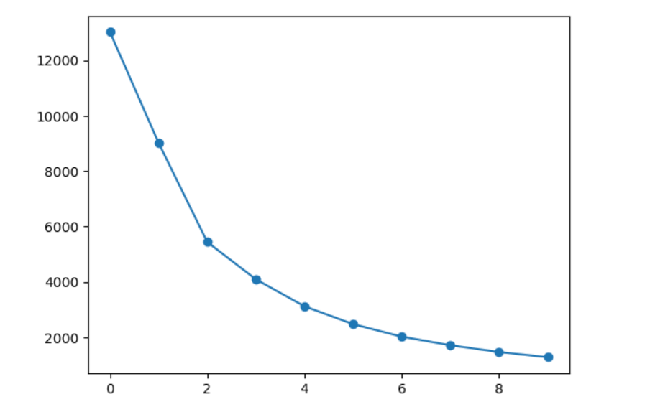
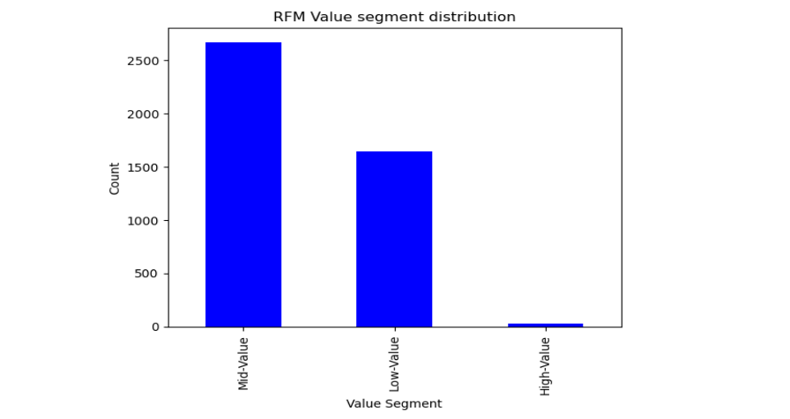
Results and Methods
Customer Segmentation
Segment Profiling

Slide 5
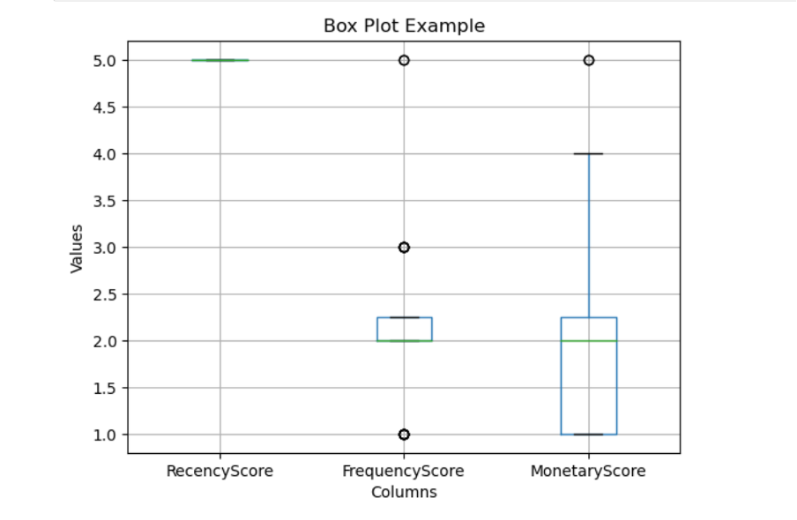
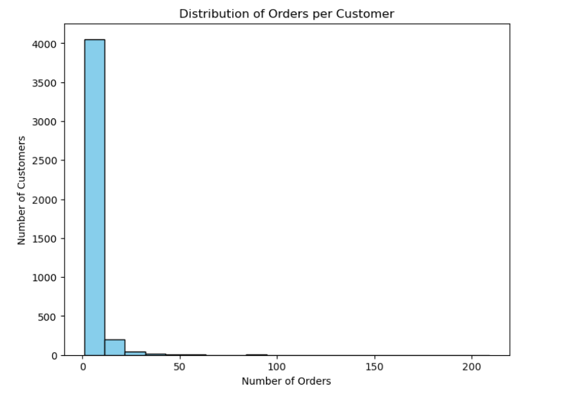
RFM DISTRIBUTION VISUALIZATION
RFM DISTRIBUTION OF ORDERS

Slide 6
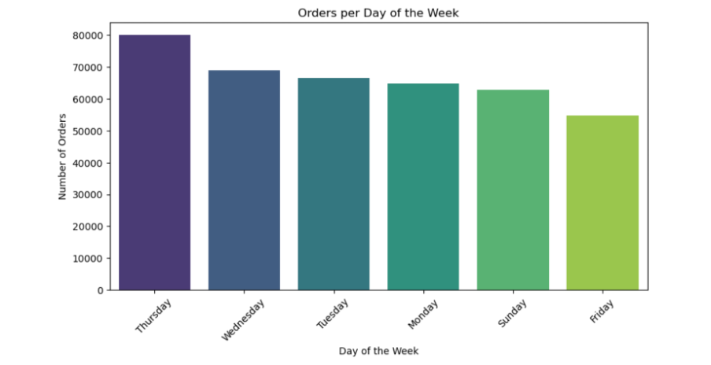
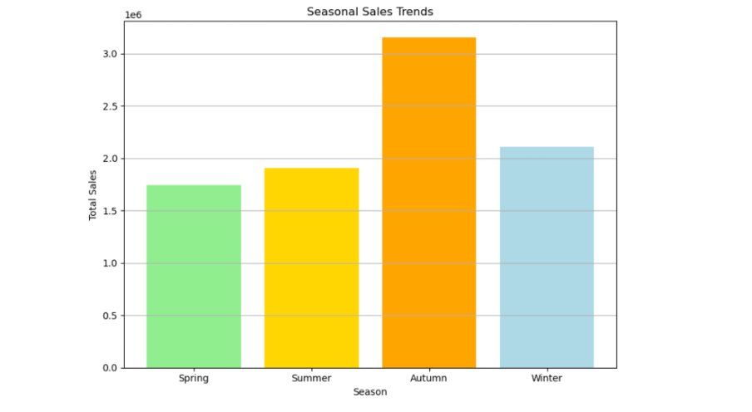
SEASONAL PATTERNS
TIME ANALYSIS

Slide 7
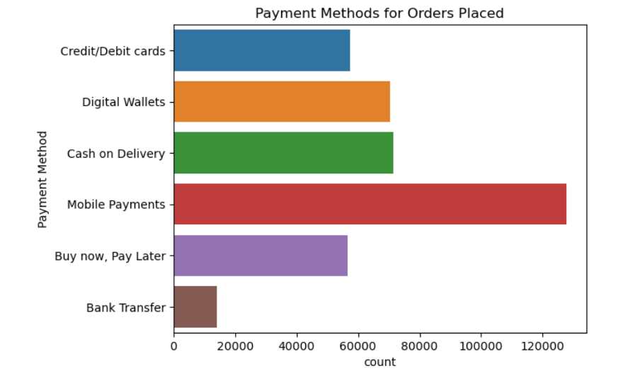
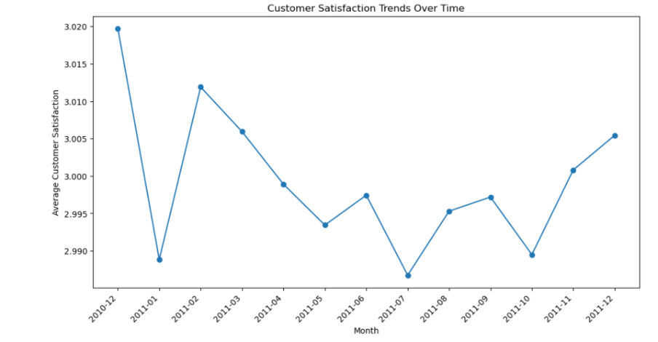
PAYMENT ANALYSIS
CUSTOMER SATISFCATION

Slide 8
Limitations
Missing Data: Incomplete or missing data in the dataset can lead to inaccurateRFM scores, affecting the segmentation results.
Data Accuracy: Inaccuracies in transaction data or errors in recording customer information may distort the RFM analysis.
Assumption of Stability: RFM analysis assumes that customer behavior remains relatively stable over time. Sudden changes in customer behavior patterns, such as during a promotion or economic event, may not be accurately captured.
Limited Customer Insights: RFM focuses on transactional data and may not capture other important aspects of customer behavior, such as preferences, feedback, or interactions with the brand.

Slide 9
Future Scope
1. Advanced Analytics and Machine Learning: Integration of advanced analytics techniques and machine learning algorithms to enhance the accuracy and predictive power of customer segmentation models.
2. Real-Time Segmentation: Development of real-time customer segmentation models that can adapt to dynamic changes in customer behavior, allowing businesses to respond promptly to emerging trends.
3. Multichannel Integration: Integration of data from multiple channels (online and offline) to create a holistic view of customer interactions, enabling more comprehensive and accurate segmentation.
4. Personalization and Hyper-Personalization: Utilization of RFM insights for personalized marketing campaigns and hyper-personalization, tailoring product recommendations, offers, and content based on individual customer preferences.

Slide 10
Thank you! ☺

